Slide 1
Primo Research Assistant
For Primo VE NDE
Yoel Kortick | May 2026

Slide 2
Agenda
  Introduction
  Enabling the Primo Research Assistant
  Relocating and renaming the Primo Research Assistant
  The Primo Research Assistant interface
  An example using the Primo Research Assistant
  Asking Primo Assistant in a language other than English
  An example in the user's native language (not English) (example 1 of 5)
  An example in the user's native language (not English) (example 2 of 5)
  An example in the user's native language (not English) (example 3 of 5)
  An example in the user's native language (not English) (example 4 of 5)
  An example in the user's native language (not English) (example 5 of 5)
  The refined search
  Copying results to an external application
  Reporting on Primo Research Assistant usage via Mixpanel

Slide 3
Introduction

Slide 4
Introduction
In addition to this presentation, it is recommended to also see
  Getting Started with Primo Research Assistant
  Natural Language Search in the NDE UI
  Ex Libris Primo Research Assistant is now available for Primo institutions (from exlibrisgroup.com)
  Ex Libris Primo Research Assistant Demo (5-minute YouTube video)
  12 How to create a Mixpanel Insights Report of Research Assistant queries for a specified time period
  13 How to create a Mixpanel Insights Report of Number of Research Assistant queries per user group for a specified time period
    The above two Mixpanel Primo Research Assistant Blogs are part of a larger series: The full Mixpanel How-To series

Slide 5
Introduction
Primo Research Assistant is
  A generative AI-powered tool designed to streamline time-intensive tasks.
  Available to all institutions using Primo VE.
Primo Research Assistant uses a Retrieval Augmented Generation (RAG) architecture to combine the language capabilities of the LLM (Large Language Model) with the knowledge from material indexed in the Central Discovery Index (CDI).
In order to use the Primo Research Assistant users must be logged in.

Slide 6
Introduction
The Primo Research Assistant allows the end user to search resources using a “natural language search query”
The term “natural language search query” may be defined as follows: “Natural language search uses natural language processing allowing users to direct search engines by speaking to it their everyday language.”¹
Example One:
  A query in the standard Primo user interface may be “Taiwan library and information science”
  A query in the Primo Research Assistant may be “What are some of the major contributions of academic universities in Taiwan in the field of library and information science?”
Example two:
  A query in the standard Primo user interface may be “mobile phones and literacy”
  A query in the Primo Research Assistant may be “What is the impact of mobile devices on reading and literacy development in children?”
1. Coveo. “What Is Natural Language Search?” https://www.coveo.com/blog/what-is-natural-language-search/. Accessed Oct. 12, 2025.

Slide 7
Introduction
After the query is sent from the Primo Research Assistant, behind the scenes Primo takes the natural language search query and goes to CDI (the Central Discovery Index) and uses a LLM (Large Language Model) to check CDI for resources for which the logged in user of the institution has access.
Based on the resources which have been found the Primo Research Assistant
  Supplies an answer to the query in an “Overview” section. The answer includes references to the resource from which the information came.
  Provides links to the top five resources on the topic, as well as a link to additional resources (“View more results from your library search”) . Clicking a resource will provide information about the resource, an abstract (when available) and a link to access the resource.
  Additional suggested related natural language search queries

Slide 8
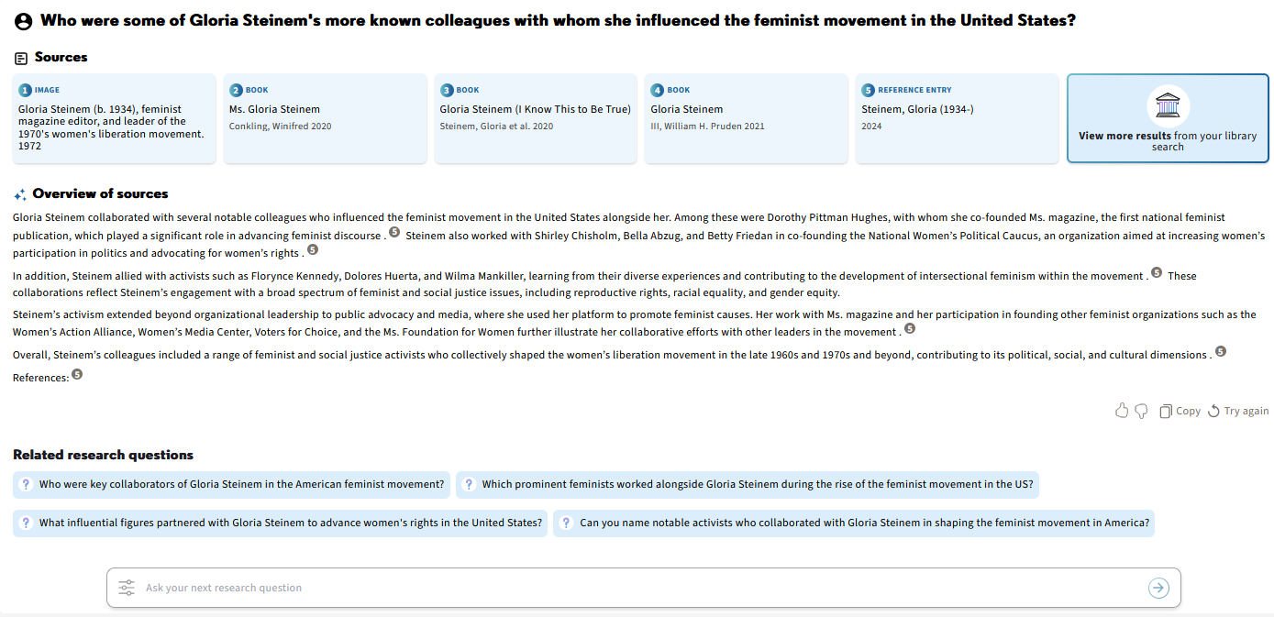
Introduction
The query sent
Links to the top five resources on the topic
Answer to the query in an “Overview” section
Answer includes hyperlink references to the resource from which the information came
  Additional suggested related natural language search queries

Slide 9
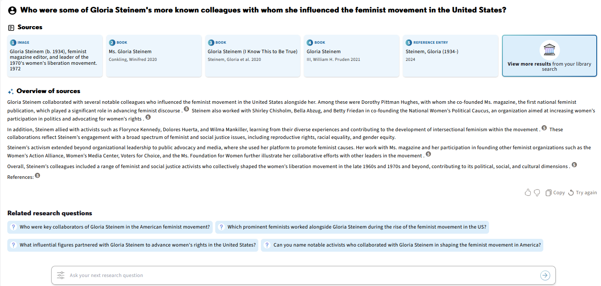
Introduction
Clicking on the “View more results” does translation from the “natural language search query” to a “complex Boolean Search” and uses that search query to find additional resources.
This “complex Boolean Search” is a search query which the end user likely would not have been able to formulate without the use of the “natural language search query” .
We will now click “View more results”

Slide 10
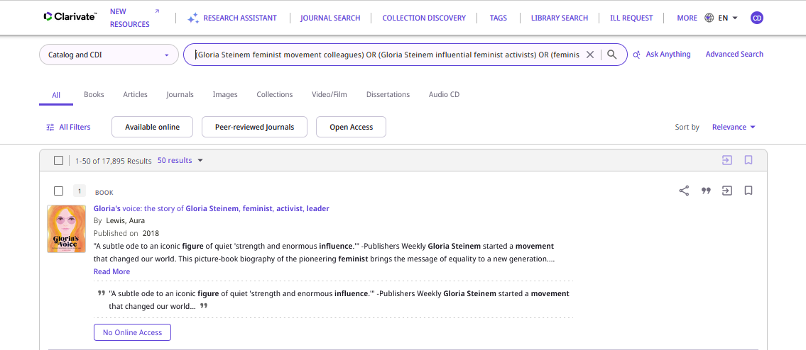
Introduction
We now have the translation from the “natural language search query” to a “complex Boolean Search”

Slide 11
Introduction
This “natural language search query”:
Who were some of Gloria Steinem's more known colleagues with whom she influenced the feminist movement in the United States?
Was converted to this “complex Boolean Search”:
(Gloria Steinem feminist movement colleagues) OR (Gloria Steinem influential feminist activists) OR (feminist leaders associated with Gloria Steinem) OR ((Gloria Steinem) OR (Betty Friedan feminist movement collaborators)) OR ((Gloria Steinem) AND (feminist movement key figures)) OR (("Gloria Steinem") AND (colleagues) AND (feminist movement) AND (United States)) OR ((Gloria Steinem feminist leaders) OR (activists US women's rights)) OR (("Gloria Steinem") AND ("feminist contemporaries") AND (influence)) OR (feminist pioneers United States 20th century Gloria Steinem associates) OR ((Gloria Steinem collaborators) OR (partners feminist activism USA)) OR (Who were some of Gloria Steinem's more known colleagues with whom she influenced the feminist movement in the United States?)

Slide 12
Introduction
Clicking a resource will provide information about the resource, an abstract (when available) and a link to access the resource.
We will now click on this resource

Slide 13
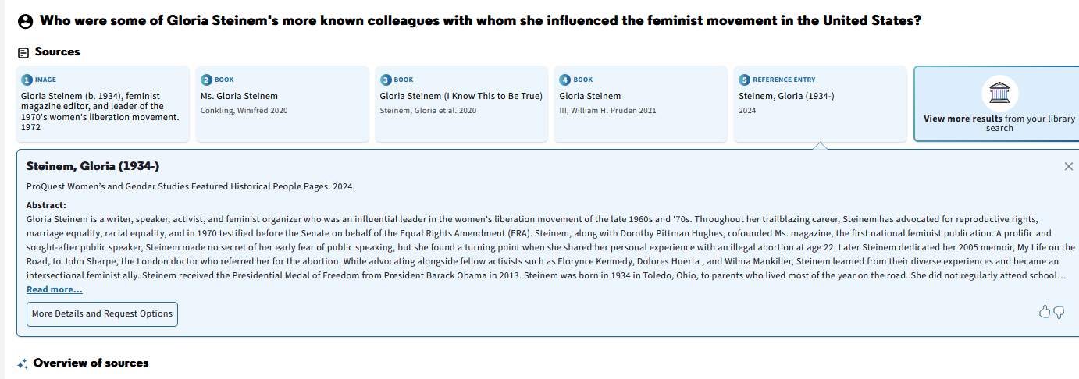
Introduction
We now have information about the resource, an abstract and a link to access the resource.

Slide 14
Introduction
The “natural language search query” can be in any language (we will see an example of this soon)
Primo takes the query and uses it in the language entered into the Primo research Assistant and also uses it translated to English.
The “Overview” comes back to the user in the same language in which he or she entered the “natural language search query”
The sources provided to the user may be in both the language in which the user entered the “natural language search query” as well as in English.

Slide 15
Enabling the Primo Research Assistant

Slide 16
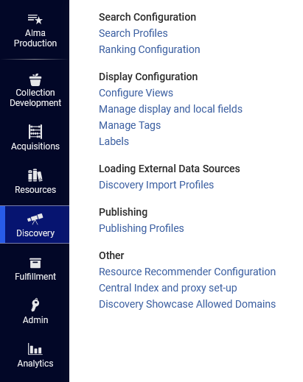
Enabling the Primo Research Assistant
Primo Research Assistant is enabled at the view level. Thus, it is not an “institution-wide” parameter but rather can be defined to display in specific Primo views.
Access and edit the view at “Discovery > Display Configuration > Configure Views”:

Slide 17
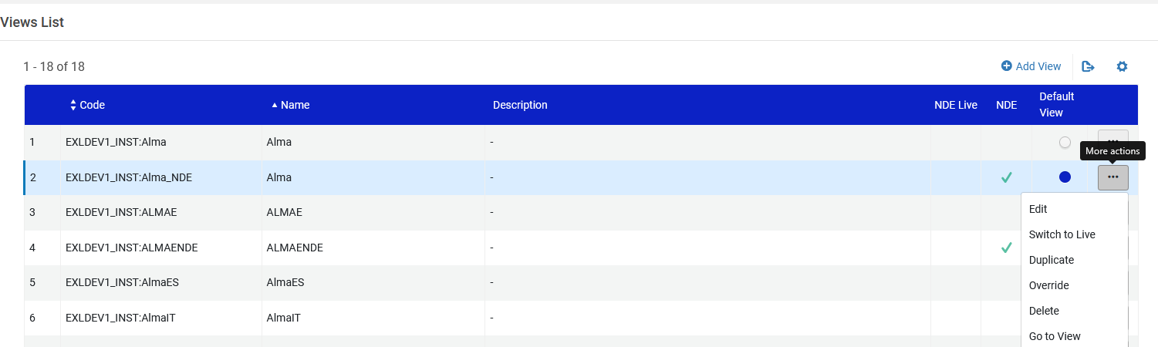
Enabling the Primo Research Assistant
Edit the desired view

Slide 18
Enabling the Primo Research Assistant
There are two options to enable the Primo Research Assistant
They are not mutually exclusive (meaning they both can be enabled)
Both parameters appear in the “General” tab when configuring the view
Enable Research Assistant Using Icon
  Displays the Primo Research Assistant icon in the Main Menu links, enabling users to access the Primo Research Assistant page from any UI page.
Enable Research Assistant Using Widget
  Displays the Primo Research Assistant widget on the right edge of the Brief Results page, enabling users to ask a question without leaving the results page. After entering the question, users are taken to the Primo Research Assistant page to view the answer.

Slide 19
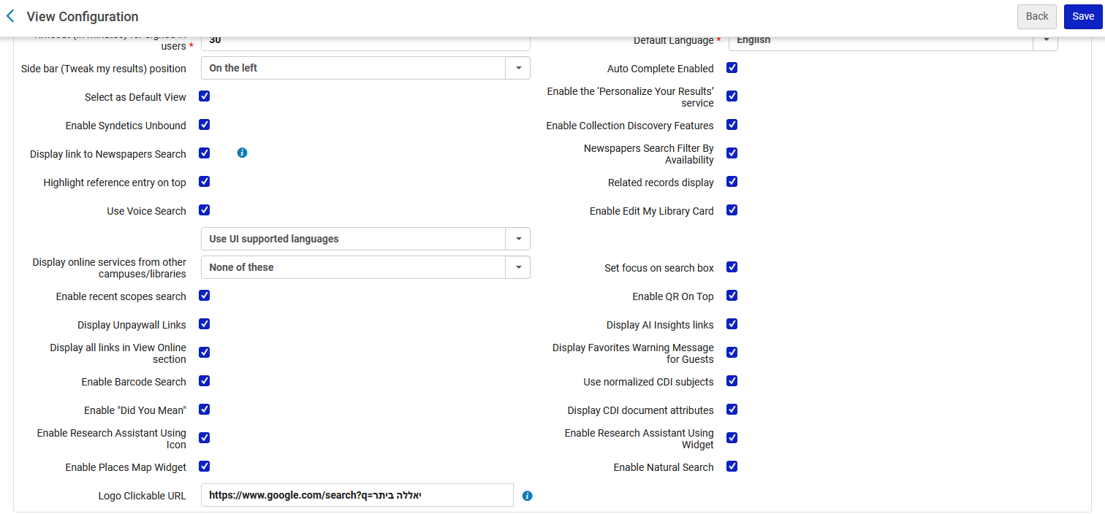
Enabling the Primo Research Assistant
We have checked both options
Enable Research Assistant Using Icon
Enable Research Assistant Using Widget

Slide 20
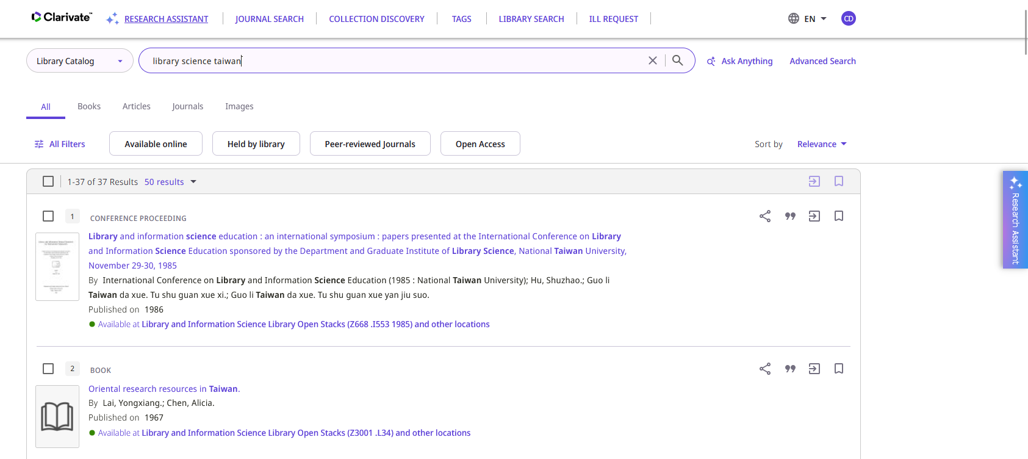
Enabling the Primo Research Assistant
Link appears in the menu because we have selected “Enable Research Assistant Using Icon”
Link appears in the brief results page because we have selected “Enable Research Assistant Using Widget”

Slide 21
Renaming and relocating the Primo Research Assistant

Slide 22
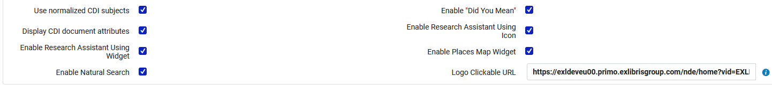
Renaming and relocating the Primo Research Assistant
The link which appears on top when the “Enable Research Assistant Using Icon” is enabled can be
  Put in a different place in the list of links
  Renamed
Note that renaming the “Research Assistant” renames it in both the link on top and on the widget on the side.
In the “General” tab of the Primo View we have “Enable Research Assistant Using Icon” and “Enable Research Assistant Using Widget” enabled

Slide 23
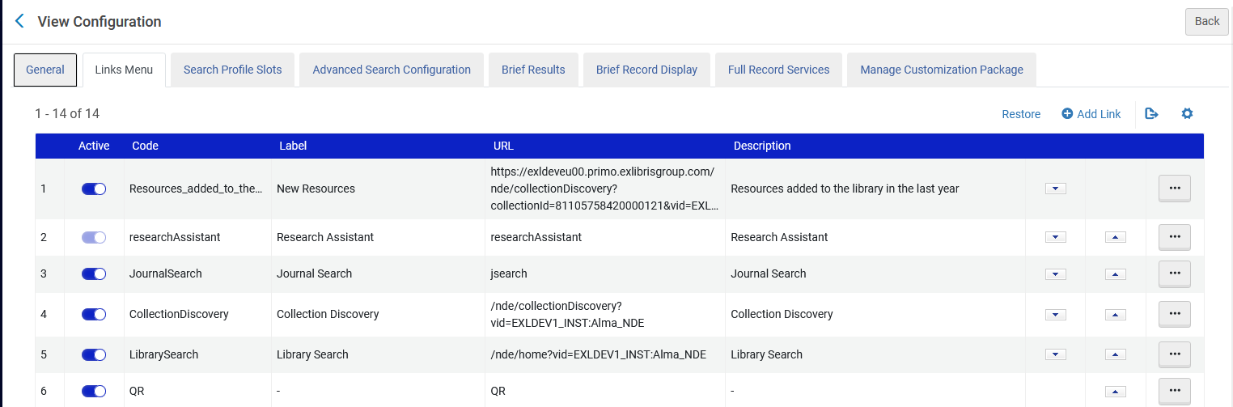
Renaming and relocating the Primo Research Assistant
In the “Links” tab of the Primo View the Research Assistant appears as the second link and is called “Research Assistant”

Slide 24
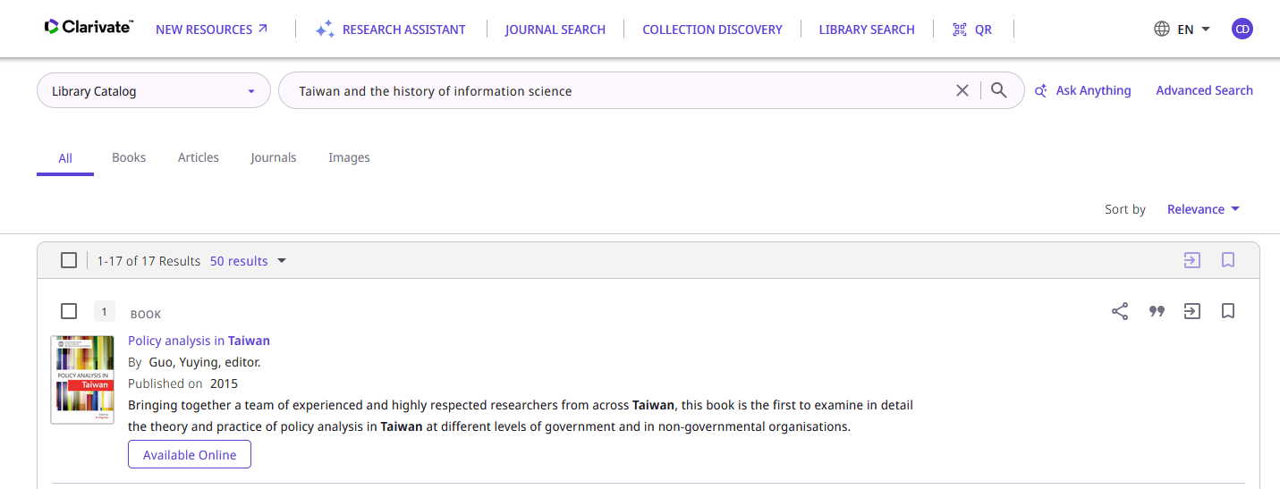
Renaming and relocating the Primo Research Assistant
Therefore, in Primo it appears as the second link and is called “Research Assistant”

Slide 25
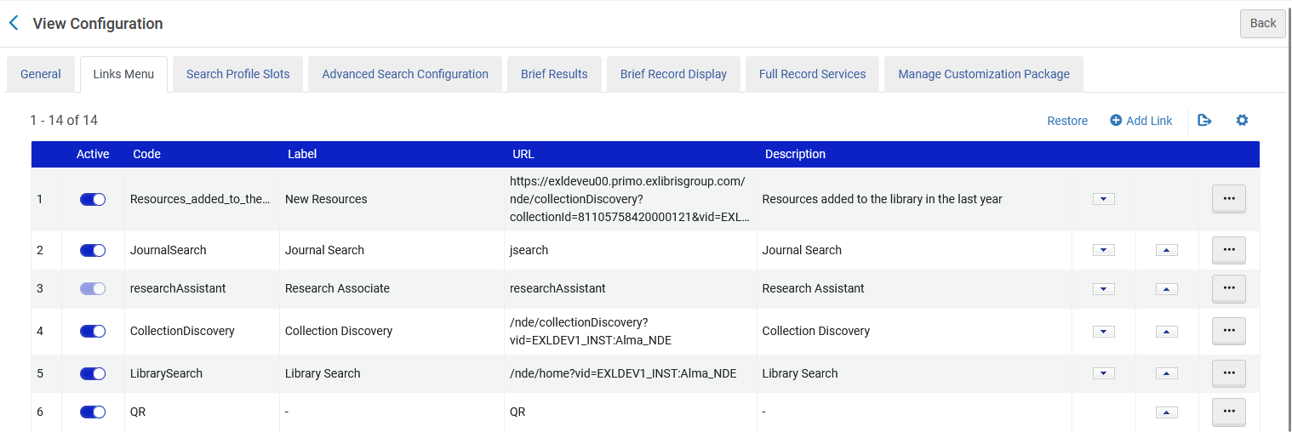
Renaming and relocating the Primo Research Assistant
Now we have decided to call it “Research Associate” and put it as the third link
We moved this to the 3rd position and renamed the label to “Research Associate” instead of “Research Assistant”

Slide 26
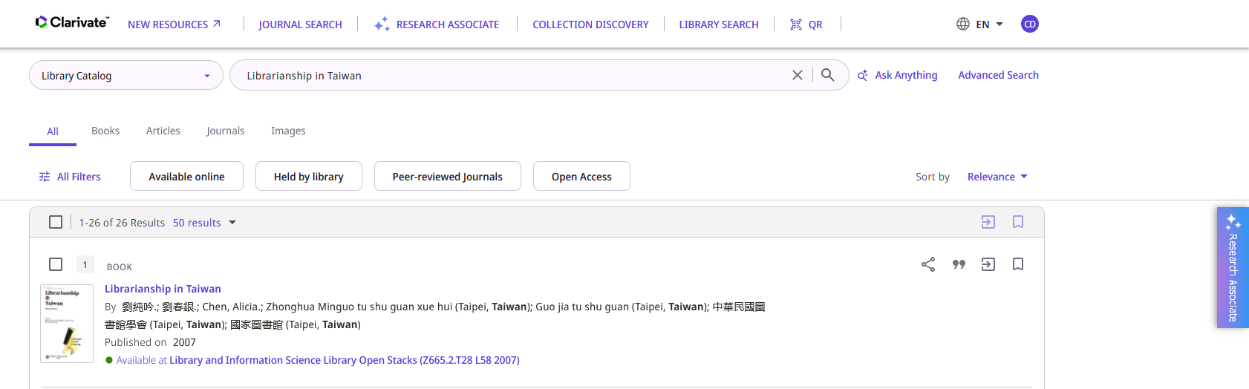
Renaming and relocating the Primo Research Assistant
Now in Primo it appears as “Research Associate” and is the third link
Note that the name of the Widget has also changed according to the value of the label in the “Links Menu” tab of the view configuration

Slide 27
The Primo Research Assistant interface

Slide 28
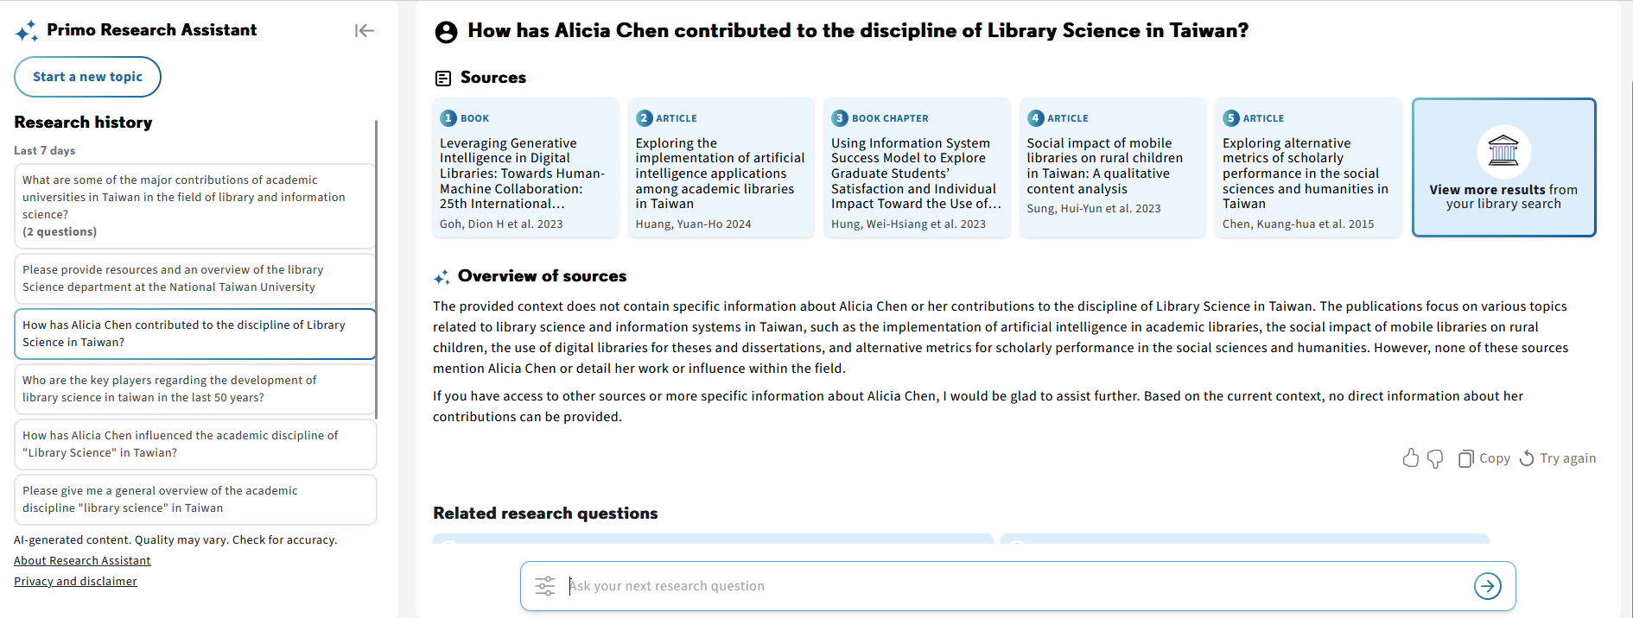
The Primo Research Assistant interface
The left pane. For more information, see Primo Research Assistant's Search History.
Enables users to start a new search
Enables users to view previous sessions that may include multiple questions.

Slide 29
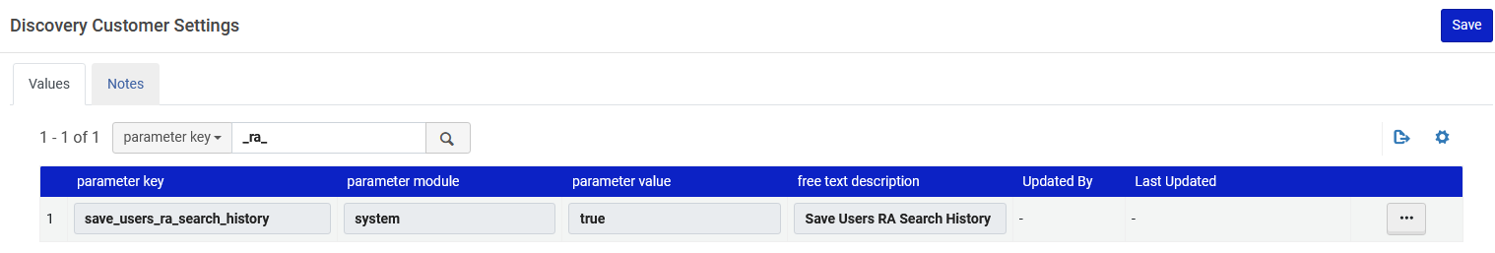
The Primo Research Assistant interface
When the save_users_RA_search_history parameter is set to true (default) on the Discovery Customer Settings page (Configuration > Discovery > Other > Customer Settings), signed-in users can save RA search history between sessions. The search history is categorized as follows:
  Today – Lists all topics researched on the current day.
  Last <1-7> days – Lists all topics researched in the previous 7 days, excluding topics researched today.
  <Year> – Lists all topics researched per year. The current year excludes the last 7 days.
We have the parameter set to true

Slide 30
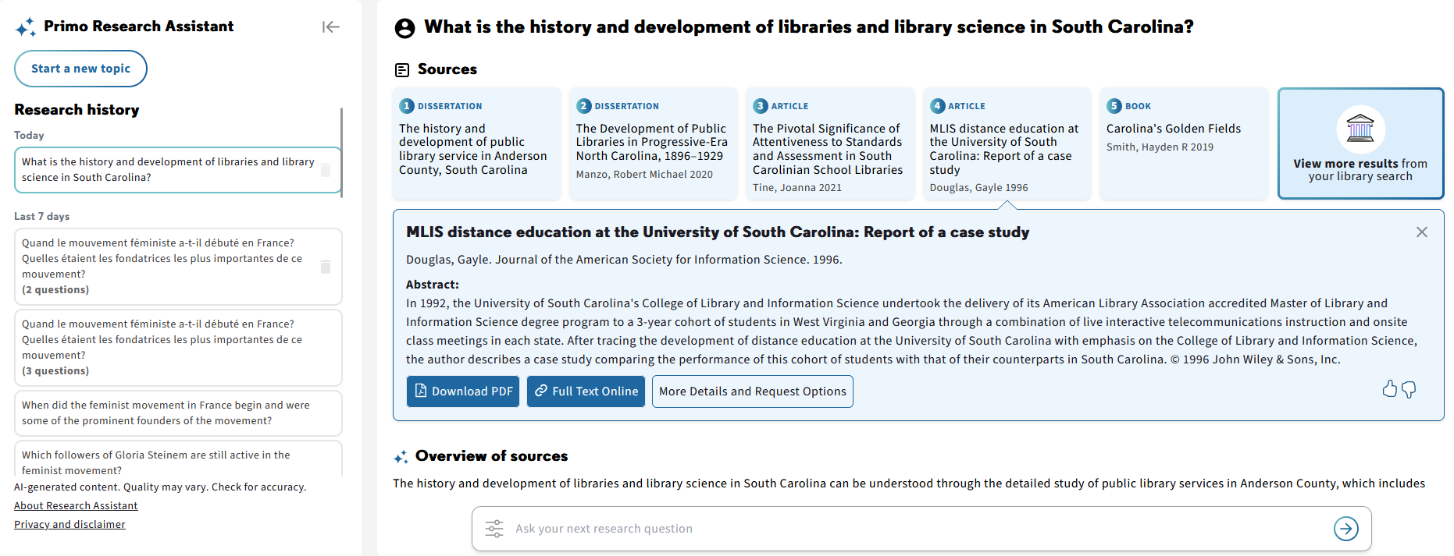
The Primo Research Assistant interface
Therefore, our search history is divided as follows chronologically

Slide 31
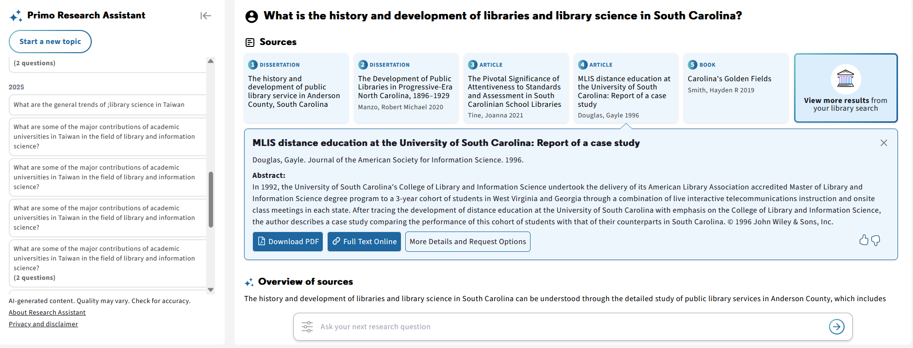
The Primo Research Assistant interface
And if we scroll down in the history we can see for the year

Slide 32
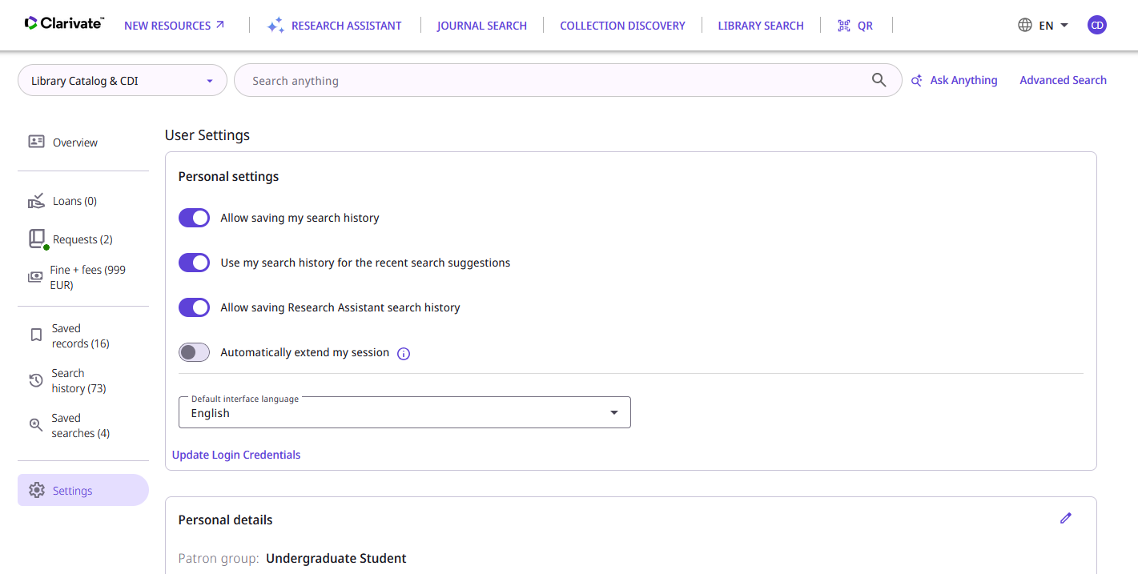
The Primo Research Assistant interface
Note that when save_users_RA_search_history is set to “true” users can decide whether to save Research Assistant searches between sessions.
This is done via the option ”Allow saving Research Assistant search” in the library card.

Slide 33
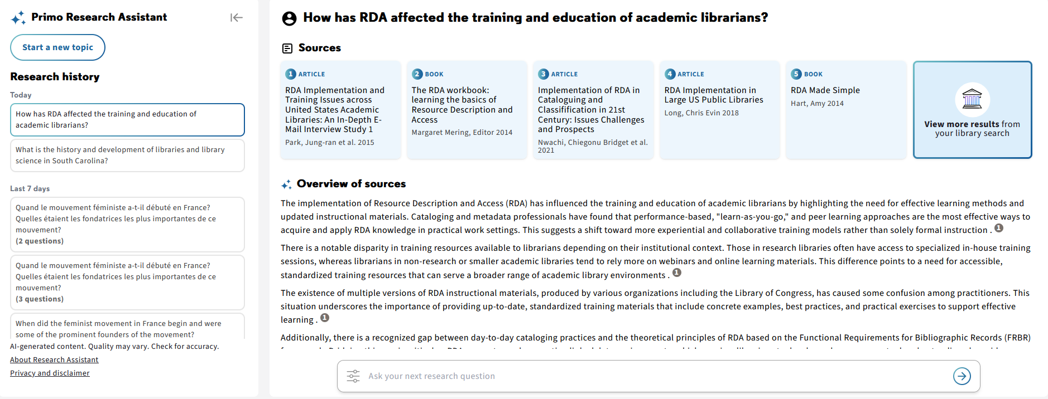
The Primo Research Assistant interface
The right pane. For more information, see Primo Research Assistant's Response.
Enables users to view their queries and responses
Enables users to enter research questions

Slide 34
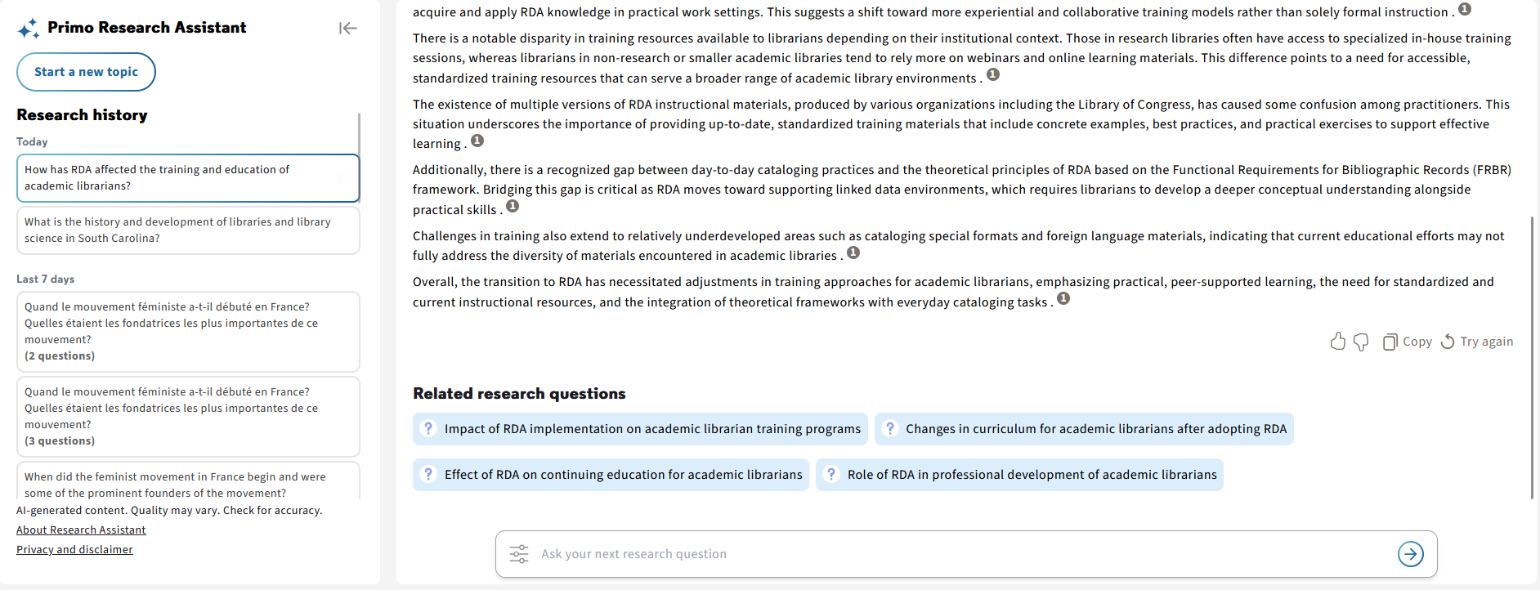
The Primo Research Assistant interface
The right pane. For more information, see Primo Research Assistant's Response.
User can also scroll down in the right pane to see “Related research questions”

Slide 35
An example using the Primo Research Assistant

Slide 36
An example using the Primo Research Assistant
We will now ask the Primo Research Assistant the following natural language search query:
What are some of the major contributions of academic universities in Taiwan in the field of library and information science?

Slide 37
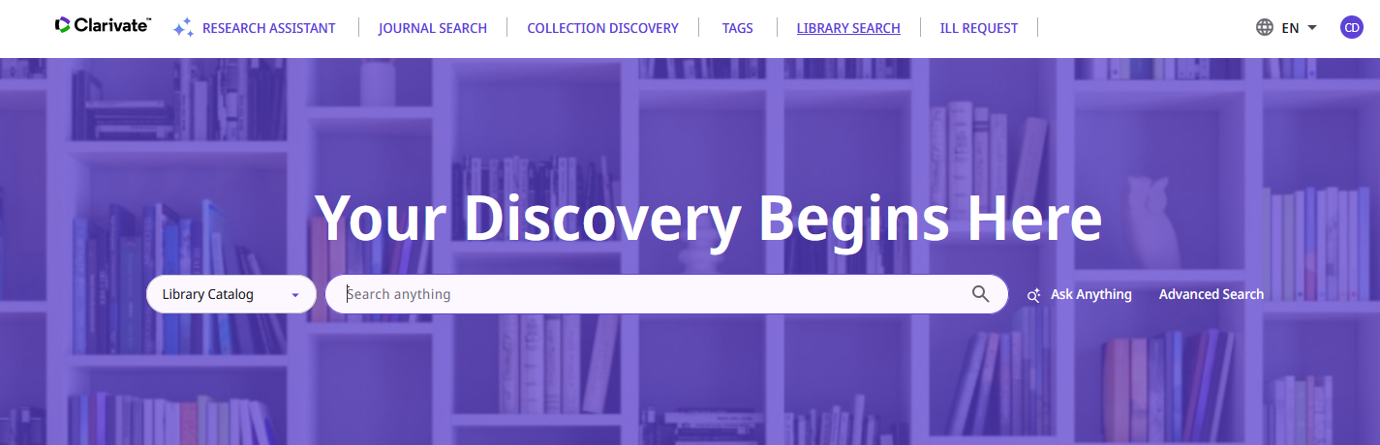
An example using the Primo Research Assistant
We will access the Primo Research Assistant

Slide 38
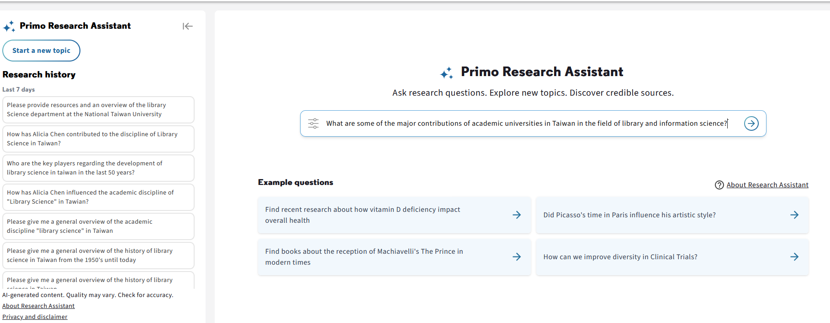
An example using the Primo Research Assistant
Submit the natural language search query
See here queries I (the logged in user have already submitted in the last 7 days)
Enter and submit query
See here sample queries

Slide 39
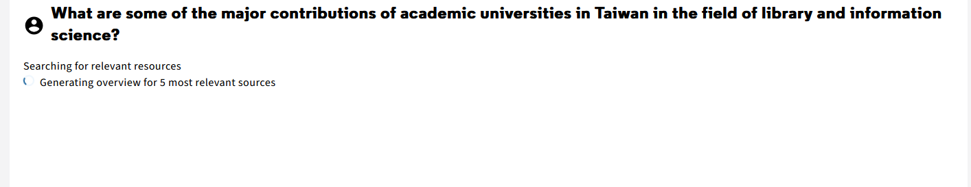
An example using the Primo Research Assistant
The Primo Research Assistant begins researching

Slide 40
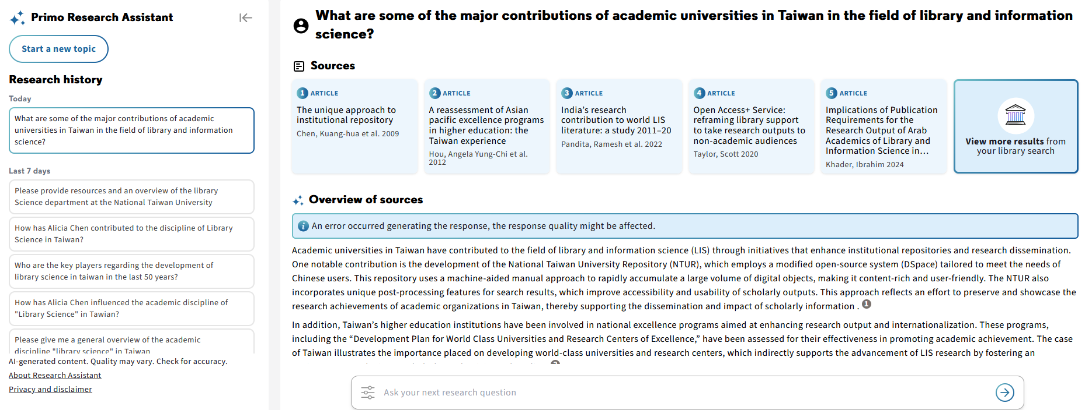
An example using the Primo Research Assistant
The Primo Research Assistant provides results
The new query is added to the history
Links to five of the resources used to provide the answer appear.
Here we have our answer.
The overview includes references to the sources

Slide 41
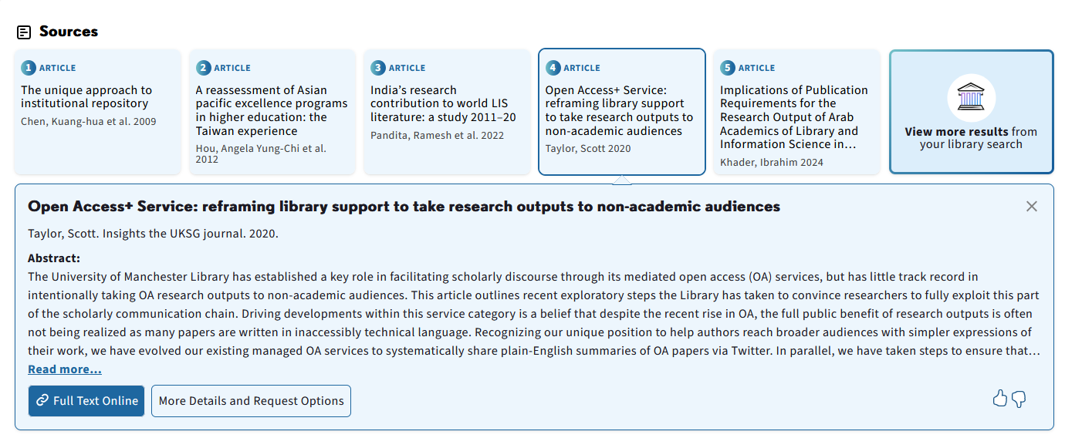
An example using the Primo Research Assistant
We will select one of the sources
We selected this resource
Here we have general information about the resource and the abstract.
Now we will click “Full Text Online”

Slide 42
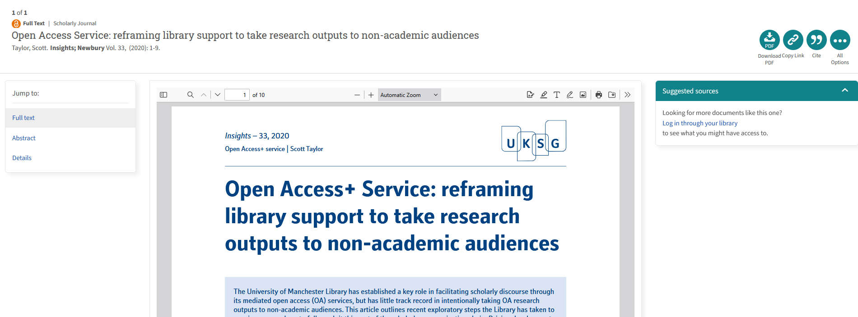
An example using the Primo Research Assistant
After clicking “Full Text Online” we can access the resource

Slide 43
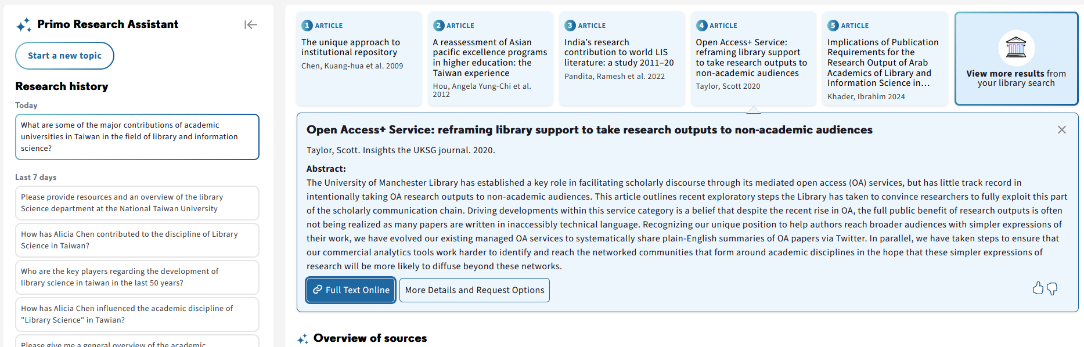
An example using the Primo Research Assistant
Now we will click “View more results from your library search”

Slide 44
An example using the Primo Research Assistant
The “natural language search query” gets translated to a “complex Boolean Search”.
The “natural language search query” | The “complex Boolean Search”
What are some of the major contributions of academic universities in Taiwan in the field of library and information science? | (("academic universities in Taiwan") AND ("library and information science") AND (contributions)) OR ((Taiwanese universities AND LIS research) OR (academic output)) OR (("library science") OR ("information science" AND Taiwan AND university achievements)) OR ((higher education Taiwan) AND ("information management") AND (impact)) OR (academic contributions Taiwan LIS) OR (What are some of the major contributions of academic universities in Taiwan in the field of library and information science?)

Slide 45
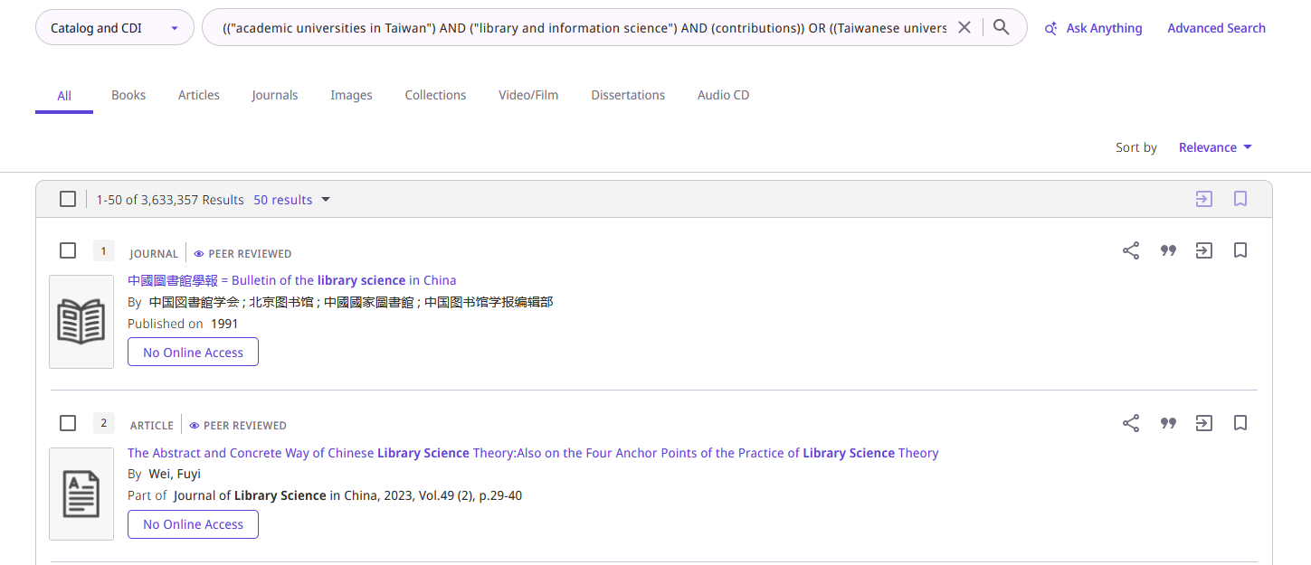
An example using the Primo Research Assistant
Here is the “complex Boolean Search” which was automatically created by the Primo Research Assistant from the “natural language search query”

Slide 46
Asking Primo Assistant in a language other than English

Slide 47
Asking Primo Assistant in a language other than English
We will now look at four different examples of the user asking Primo Assistant in a language other than English.
We will see that when a language other than English is used:
The resources provided by Primo Assistant will be in English and the language used (provided there are resources in the language used)
The overview answer provided by Primo Assistant will be in the language used
The suggested related questions provided by Primo Assistant will be in the language used

Slide 48
Asking Primo Assistant in a language other than English
For example, we could ask the following question any of these languages (but here we will do only four examples)
Language | Query
English | How has RDA affected the training and education of academic librarians?
French | Comment la RDA a-t-elle influencé la formation professionnelle et l’enseignement de bibliothécaires académiques?
Traditional Chinese | RDA對學術圖書館員的訓練和教育產生了哪些影響？
Italian | In che modo l'RDA ha influenzato la formazione e l’istruzione dei bibliotecari accademici?
Dutch | Hoe heeft RDA de opleiding en het onderwijs van academische bibliothecarissen beïnvloed?
German | Wie hat sich die Einführung von RDA auf die Ausbildung und Weiterbildung von wissenschaftlichen Bibliothekaren ausgewirkt?
Hebrew | כיצד השפיע RDA על הכשרתם והשכלתם של ספרנים אקדמיים?
Spanish | ¿Cómo ha afectado la RDA a la formación y educación de los bibliotecarios académicos?

Slide 49
An example in the user's native language (not English) (example 1 of 5)

Slide 50
An example in the user's native language (not English) - 1
We will now use the Primo Research Assistant in our native language (in this case French).
The “natural language search query” in English | The “natural language search query” in French
How has RDA affected the training and education of academic librarians? | Comment la RDA a-t-elle influencé la formation professionnelle et l’enseignement de bibliothécaires académiques?

Slide 51
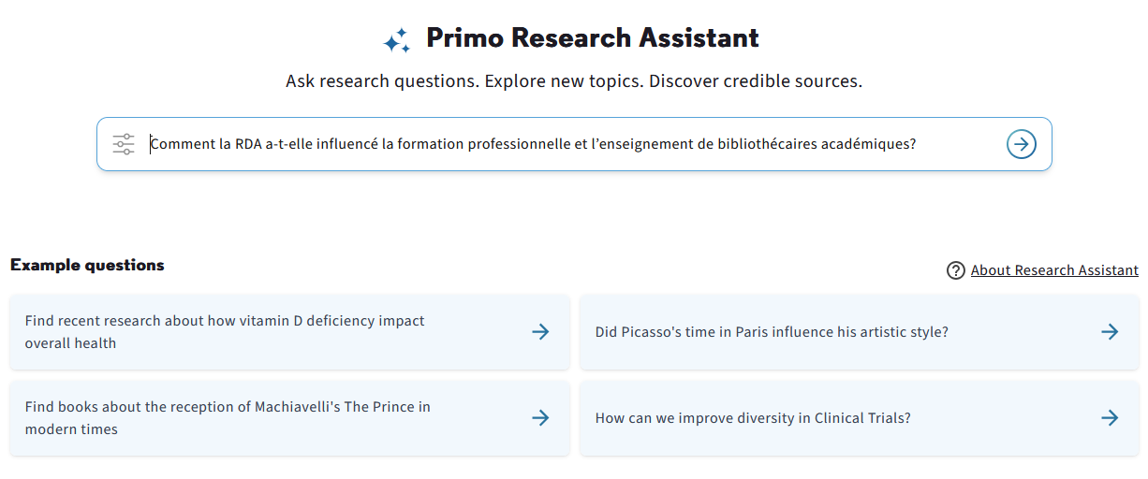
An example in the user's native language (not English) - 1
We use the Primo Research Assistant in our native language (in this case French).

Slide 52
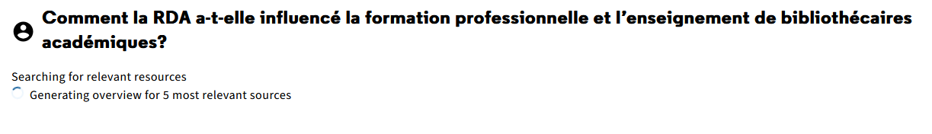
An example in the user's native language (not English) - 1
The Primo Research Assistant begins working

Slide 53
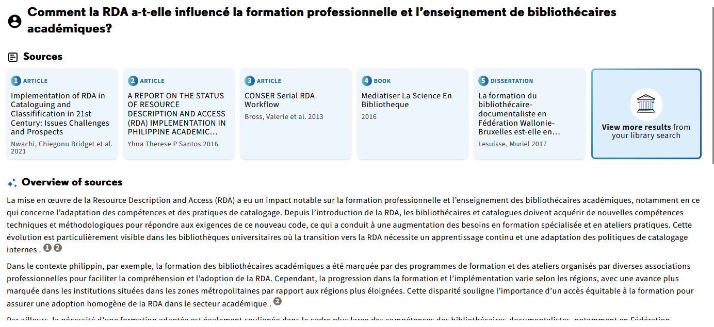
An example in the user's native language (not English) - 1
The Primo Research Assistant returns results
Resources in multiple languages: the language we used in the query and English
Overview in French
The overview includes references to the sources

Slide 54
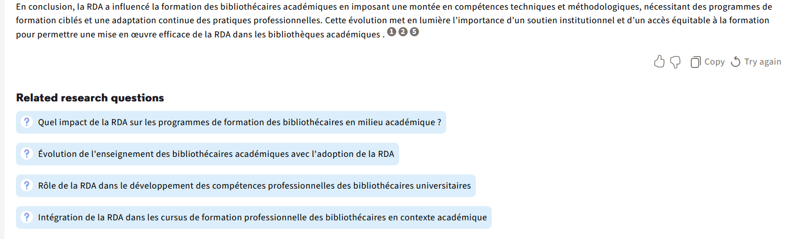
An example in the user's native language (not English) - 1
The suggested related questions are also in French

Slide 55
An example in the user's native language (not English) (example 2 of 5)

Slide 56
An example in the user's native language (not English) - 2
We will now use the Primo Research Assistant in our native language (in this case Traditional Chinese).
The “natural language search query” in English | The “natural language search query” in Traditional Chinese
How has RDA affected the training and education of academic librarians? | RDA對學術圖書館員的訓練和教育產生了哪些影響？

Slide 57
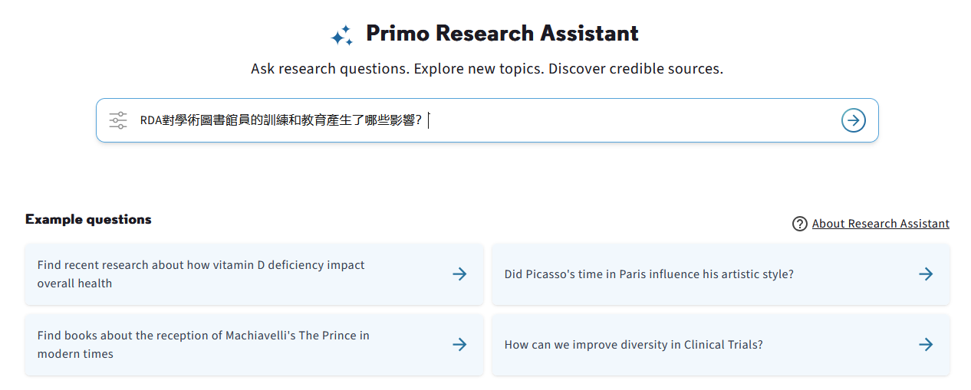
An example in the user's native language (not English) - 2
We use the Primo Research Assistant in our native language (in this case Traditional Chinese).

Slide 58
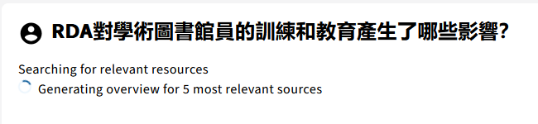
An example in the user's native language (not English) - 2
The Primo Research Assistant begins working

Slide 59
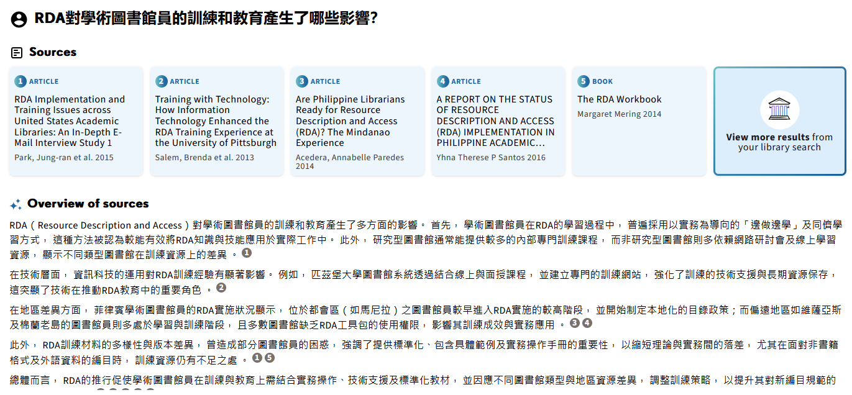
An example in the user's native language (not English) - 2
The Primo Research Assistant returns results
Overview in Traditional Chinese
The overview includes references to the sources

Slide 60
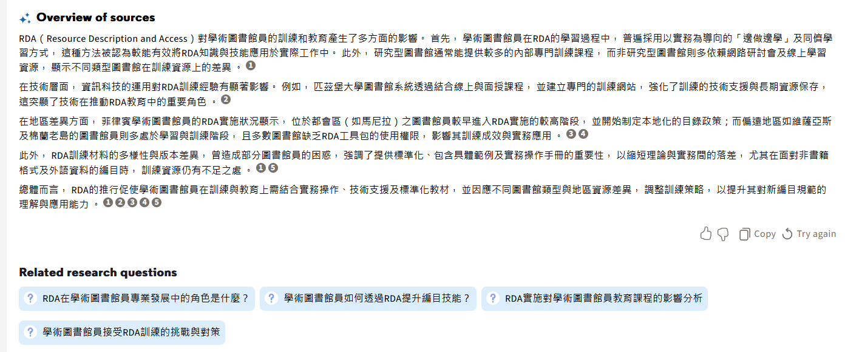
An example in the user's native language (not English) - 2
The suggested related questions are also in Traditional Chinese

Slide 61
An example in the user's native language (not English) (example 3 of 5)

Slide 62
An example in the user's native language (not English) - 3
We will now use the Primo Research Assistant in our native language (in this case Italian).
The “natural language search query” in English | The “natural language search query” in Italian
How has RDA affected the training and education of academic librarians? | In che modo l'RDA ha influenzato la formazione e l’istruzione dei bibliotecari accademici?

Slide 63
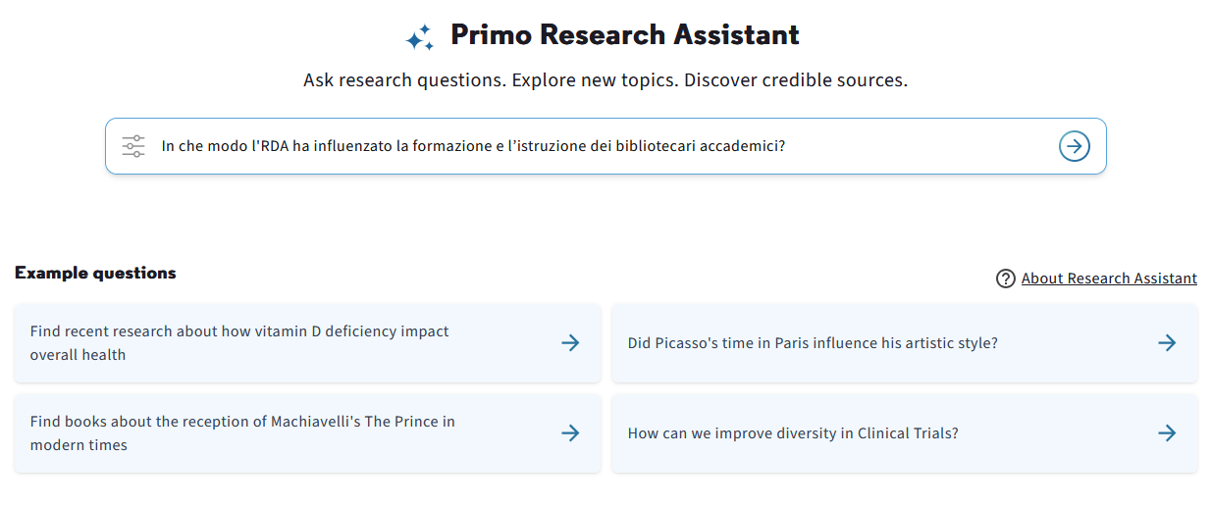
An example in the user's native language (not English) - 3
We use the Primo Research Assistant in our native language (in this case Italian).

Slide 64
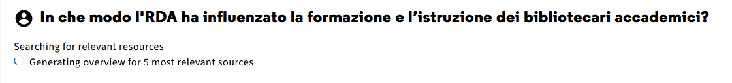
An example in the user's native language (not English) - 3
The Primo Research Assistant begins working

Slide 65
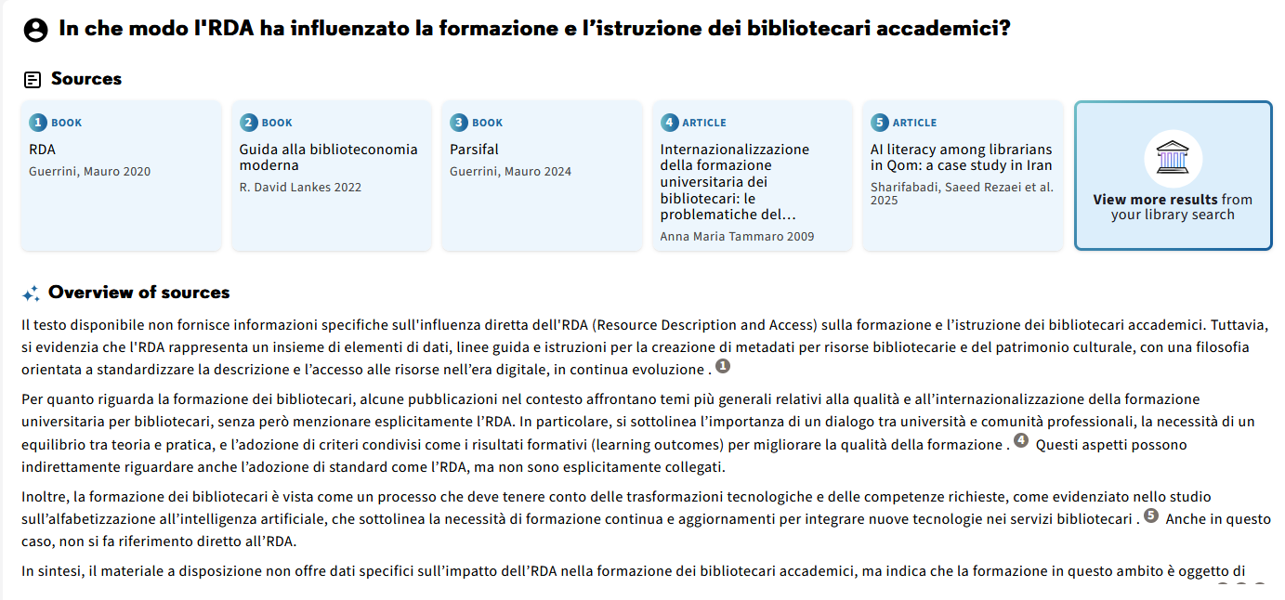
An example in the user's native language (not English) - 3
The Primo Research Assistant returns results
Resources are in English and Italian
Overview in Italian
The overview includes references to the sources

Slide 66
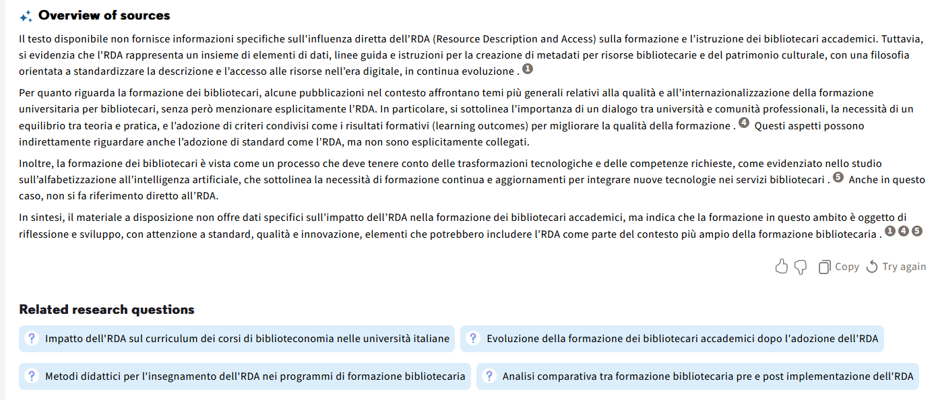
An example in the user's native language (not English) - 3
The suggested related questions are also in Italian

Slide 67
An example in the user's native language (not English) (example 4 of 5)

Slide 68
An example in the user's native language (not English) - 4
We will now use the Primo Research Assistant in our native language (in this case Hebrew).
The “natural language search query” in English | The “natural language search query” in Hebrew
How has RDA affected the training and education of academic librarians? | כיצד השפיע RDA על הכשרתם והשכלתם של ספרנים אקדמיים?

Slide 69
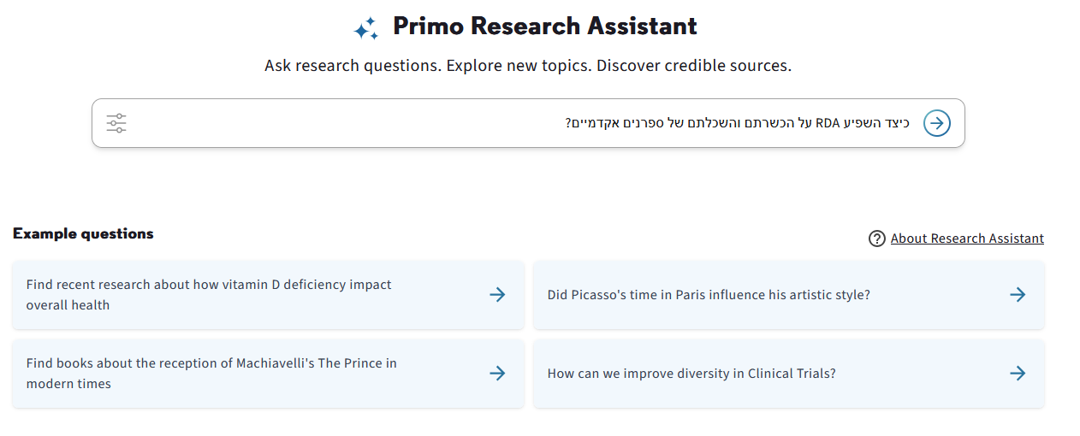
An example in the user's native language (not English) - 4
We use the Primo Research Assistant in our native language (in this case Hebrew).

Slide 70
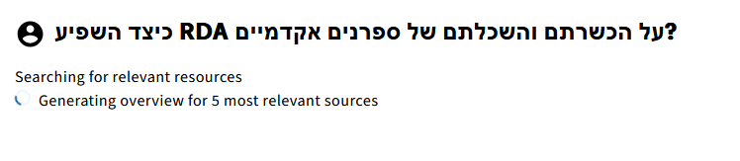
An example in the user's native language (not English) - 4
The Primo Research Assistant begins working

Slide 71
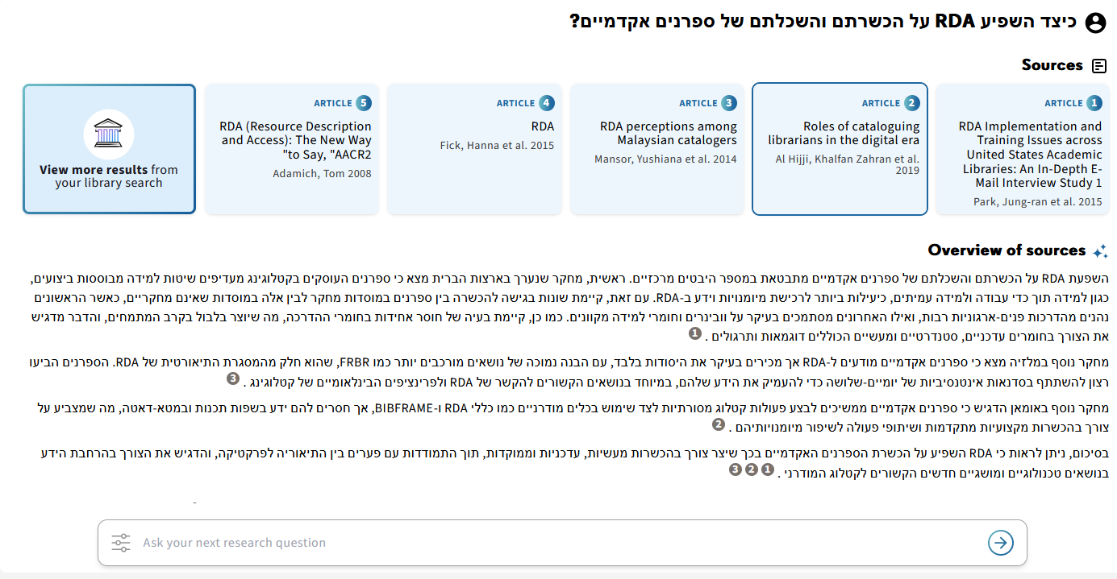
An example in the user's native language (not English) - 4
The Primo Research Assistant returns results
In this case the resources are in English because we do not have relevant resources in the language of the query
Overview in Hebrew
The overview includes references to the sources

Slide 72
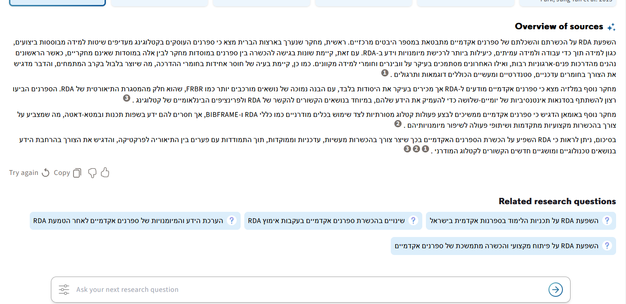
An example in the user's native language (not English) - 4
The suggested related questions are also in Hebrew

Slide 73
An example in the user's native language (not English) (example 5 of 5)

Slide 74
An example in the user's native language (not English) - 5
We will now use the Primo Research Assistant in our native language (in this case Polish).
The “natural language search query” in English | The “natural language search query” in Polish
What are some of the major changes we will be seeing in the field of library and information science in the coming five years? What will be the new trends and "buzz words"? | Jakich znaczących zmian możemy się spodziewać w dziedzinie bibliotekoznawstwa i informacji naukowej w przeciągu najbliższych pięciu lat? Jakie pojawią się trendy i słowa klucze?

Slide 75
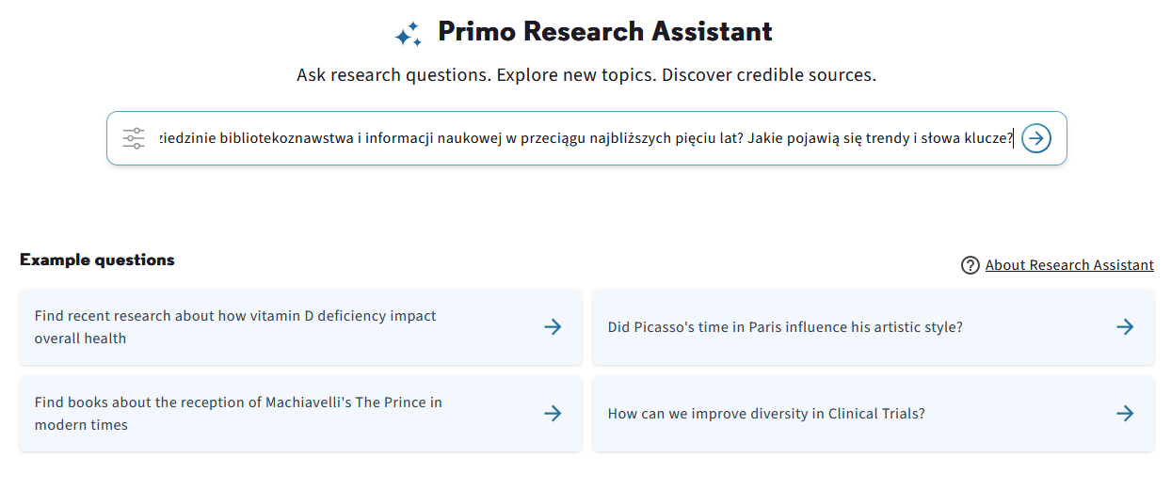
An example in the user's native language (not English) - 5
We use the Primo Research Assistant in our native language (in this case Polish).

Slide 76
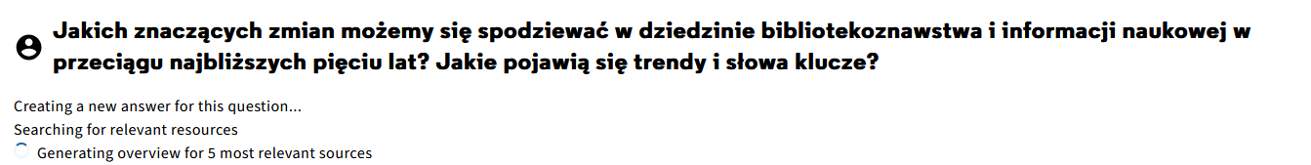
An example in the user's native language (not English) - 5
The Primo Research Assistant begins working

Slide 77
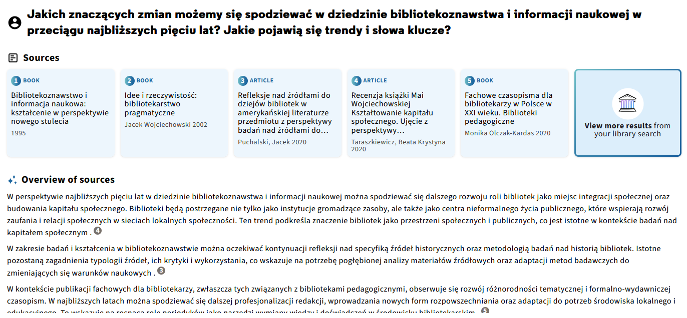
An example in the user's native language (not English) - 5
The Primo Research Assistant returns results
In this case the resources are in Polish (because we do have relevant resources in the language of the query)
Overview in Polish
The overview includes references to the sources

Slide 78
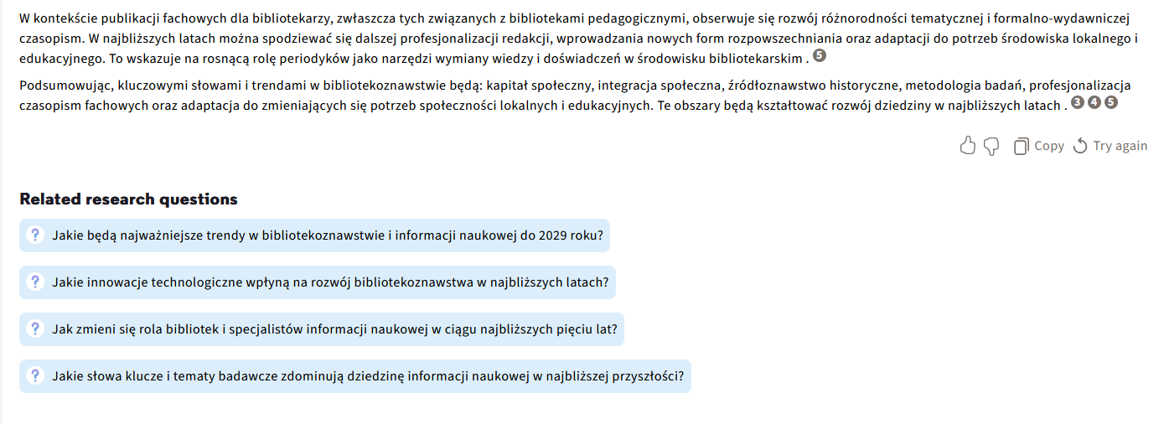
An example in the user's native language (not English) - 5
The suggested related questions are also in Polish

Slide 79
The refined search

Slide 80
The refined search
Users can refine their searches by
  Resource type (Books, Journal articles, and Peer-reviewed)
  Date (Last 12 months, Last 5 years, Last 10 years, or a Custom date)
  If available online
This is done by selecting the “Refinement” icon next to the Search Box. This will open the refinement options.
The default settings are all types and all dates.
In addition, the user can choose the Online availability check box to filter results by availability

Slide 81
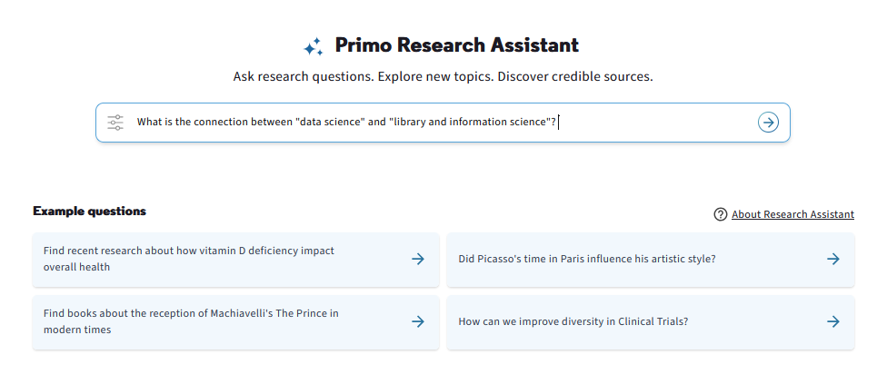
The refined search
We will click the refinement icon next to the search box before submitting our query

Slide 82
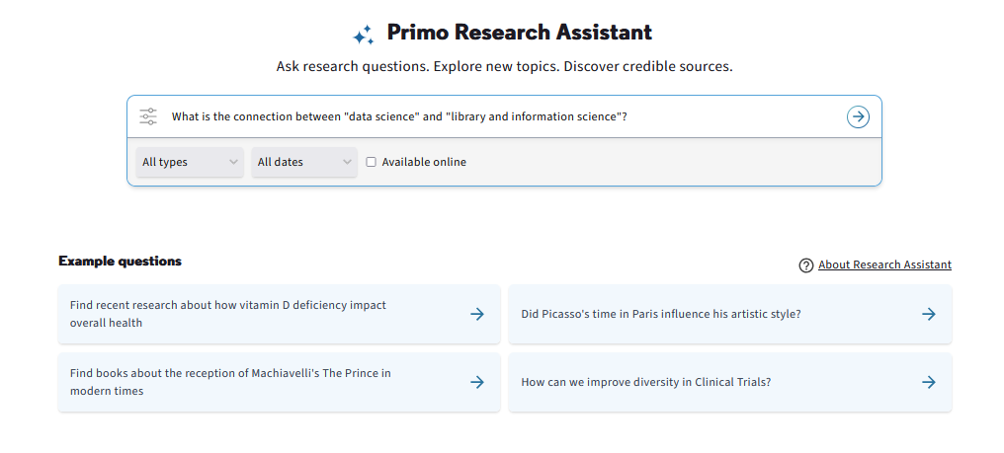
The refined search
Now we can filter by Resource type, Date and If available online

Slide 83

The refined search
Now we have filtered by journal articles which are available online for any date

Slide 84

The refined search
All resources are journal articles available online for any date

Slide 85

The refined search
Now we refine the results (and change “all dates” to “last 12 months”)
Click “Try again” to copy the query to the new search box and run it again (or edit it and run again)

Slide 86

The refined search
The results meet our refined search criteria.
All resources are journal articles from the last 12 months

Slide 87
Copying results to an external application

Slide 88
Copying results to an external application
The results of the primo Research Assistant can be copied by the user.
This allows the user to use the results in another application, such as Microsoft Word.
In the example here we will copy the results of the Primo research Assistant initial query to a Microsoft Word document.

Slide 89

Copying results to an external application
We will ask the Primo Research Assistant “How and why did Sheryl Sandberg start the Lean In movement?”

Slide 90

Copying results to an external application
From the results we will click “Copy”

Slide 91

Copying results to an external application
We can now paste to Microsoft Word.
It includes the question and overview of sources with references to the sources …

Slide 92

Copying results to an external application
It also includes the resources with an abstract and link to the resources.

Slide 93
Reporting on Primo Research Assistant usage via Mixpanel

Slide 94
Reporting on Primo Research Assistant usage via Mixpanel
For information about reporting on Primo Research Assistant usage via Mixpanel see:
  12 How to create a Mixpanel Insights Report of Research Assistant queries for a specified time period
  13 How to create a Mixpanel Insights Report of Number of Research Assistant queries per user group for a specified time period
The above two Mixpanel Primo Research Assistant Blogs are part of a larger series: The full Mixpanel How-To series

Slide 95
Thank You

